Slide 1
Real Estate Broker Application

Slide 2
Technologies
Java 8
Spring Boot
Spring Security
Angular | React
PostgreSQL | MYSQL
Maven | Gradle

Slide 3
Problem Statement
To Create an Application for online Real Estate buying/selling
Broker should be able to add/update/delete properties.
Customer should be able to:
See the list of properties available for buying/renting based on criteria such as:
Property type i.e. Flat/Shop/Plot
Offer type i.e. Sell/Rent
City
Price range min to max
2. Buy/rent a property listed by Broker.
3. Once bought/rented property should no longer be available for others.
4. See the properties he owned or rented

Slide 4
Plan
Design
Generate the skeleton as per class design provided
TDD approach
Identify test cases for each module
Write Failing Test cases
Convert the Test Cases in GREEN
Implement the case study in incremental manner

Slide 5
Modules
Login Module
Customer Module
Broker
Module
Property
Module
Property
Search
Module
Deal
Module

Slide 6
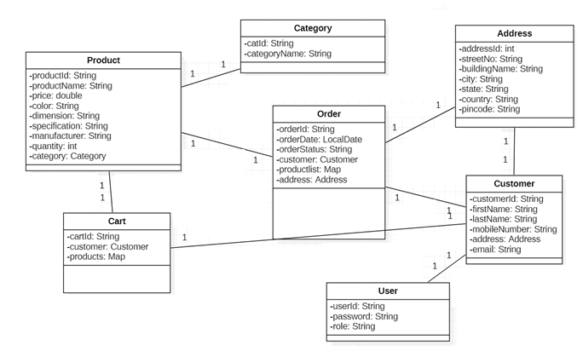
Class Design [POJO Classes]

Slide 7
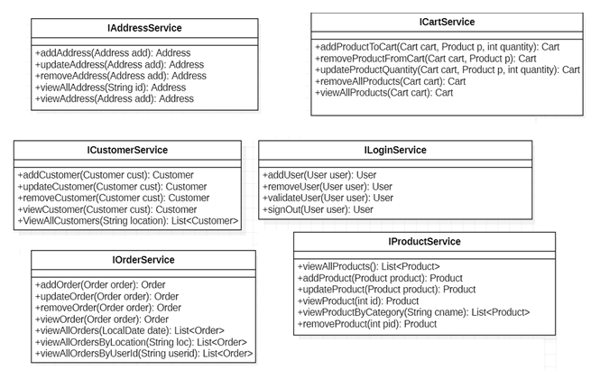
Class Design [Service Interface]

Slide 8
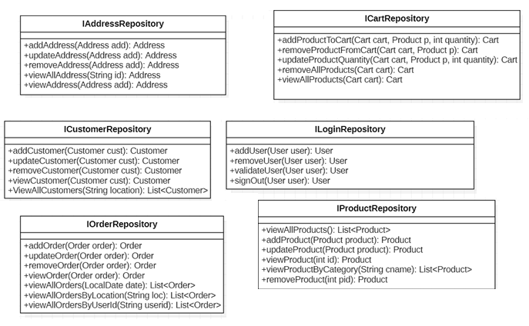
Class Design [Repository]

